Slide 1
The PIC microcontroller
PIC18F4520: Instruction Set – Part 2

Slide 2
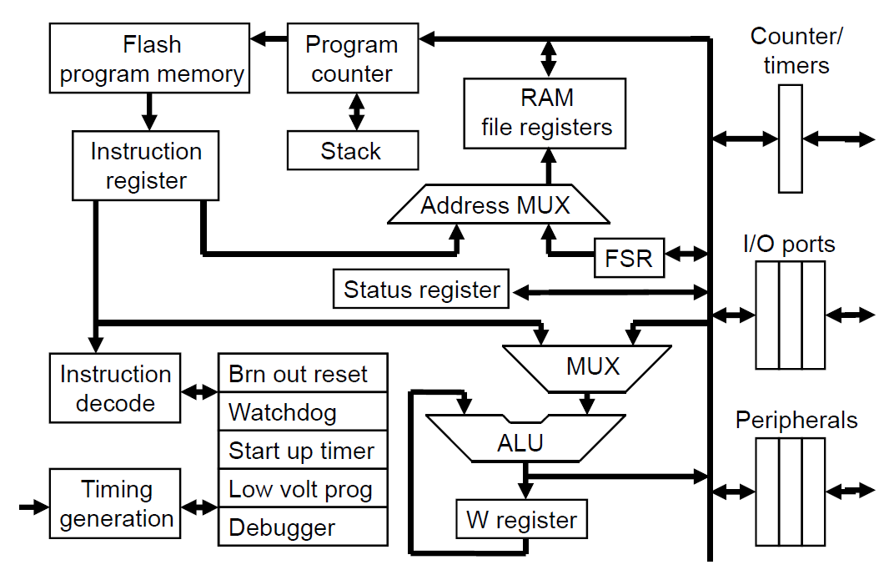
PIC18F: Controller Architecture

Slide 3
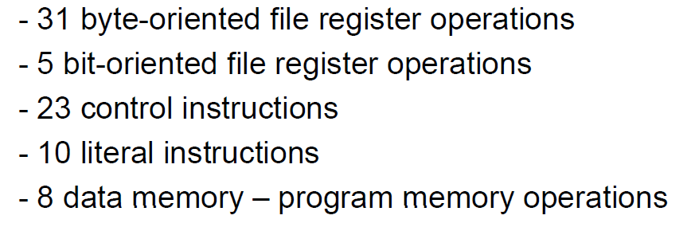
PIC18F: Instruction set grouping

Slide 4
PIC18F: Notational convention
WREG
W Register
FREG
File Register (any register location from GPR Bank 0 / SFR)
[X]
Contents of register X
[WREG] = 0x02 ↔ WREG’s contents become 0x02
[0x20] = 0x34 ↔ RAM File Register 0x20 content becomes 0x34
[X] = [Y] ↔ Contents of Y are copied into X
Number systems
Decimal | d’10’
Hexadecimal | h’4A’ or 0x4A
Binary | b’1000 0010’

Slide 5
control instructions

Slide 6
Programming: Concept of branch
Usually, program flow is sequential
Instructions execute one after another in sequence
Effect: [PC] = [PC] + <size_of_instruction>
In certain scenarios, we may want to break this sequence
Unconditional jumps
Conditional jumps
Function / sub-routine calls (and returns)
Interrupts / urgency
This disturbance of sequentiality is called branching
The controller is said to have branched off
Instruction execution continues from a different point in the code
Effect = [PC] ≠ [PC] + <size_of_instruction>

Slide 7
PIC18F: Branching - unconditional
GOTO
Go To the label mentioned
This label must exist somewhere in the code!
Example: Consider the code snippet
…
MOVLW 0x0
GOTO LABEL1
ADDWF 0x20
SUBWF 0x30
LABEL1 CLRF 0x20
SETF 0x40
…
GOTO is a 4-byte instruction with 20-bits for jump-address
Called Long Jump
Jump range: Anywhere within code-space

Slide 8
PIC18F: Branching - unconditional
BRA
Branch to the label mentioned
This label must exist somewhere in the code!
Example: Consider the code snippet
…
MOVLW 0x0
BRA LABEL1
ADDWF 0x20
SUBWF 0x30
LABEL1 CLRF 0x20
SETF 0x40
…
BRA is a 2-byte instruction with 11-bits for jump-address
Called Short Jump
Jump range: ± 2¹⁰ : -1023 to +1024

Slide 9
PIC18F: Branching – conditional
Conditions for branching:
Zero flag
BZ, BNZ
Carry flag
BC, BNC
Negative flag
BN, BNN
Overflow flag:
BOV, BNOV
Most popular, intuitive: zero-flag based branching (BZ, BNZ)
All conditional branches are 2-byte instructions
1-byte for jump address
Short jumps, range: -127 to +128

Slide 10
PIC18F: Branching – conditional (Z/NZ)
BZ
Branch if zero flag is set – result of previous ALU operation is 0
Example: Consider the code snippet
…
DECF 0x20 Zero flag will be set if result is 0
BZ LABEL1
MOVLW 0x00
MULLW 0x30
CLRF 0x16
LABEL1 ADDWF 0x01
SETF 0x30 After DECF:
… Case 1: [0x20] ≠ 0x0
Case 2: [0x20] = 0x0
BNZ
Branch if not zero

Slide 11
PIC18F: Journey so far
Unconditional jumps
GOTO
BRA
Conditional jumps
BZ, BNZ
BC, BNC
BN, BNN
BOV, BNOV

Slide 12
PIC18F: An exercise in coding!
Problem statement
To an initialized WREG, add 4, 5 times
Mental exercise
Start with WREG = 0x0
Add the number 4 (0x04) 5 times to W
What is the expected result?
Pseudo-code / algo:
[WREG] = 0x0
[WREG] = [WREG] + 0x04 ---- do this 5 times
[WREG] = ??

Slide 13
PIC18F: Exercise – attempt #1
Let’s try using literal instructions:
MOVLW 0x00 [WREG] = ?
ADDLW 0x04 [WREG] = ?
ADDLW 0x04 [WREG] = ?
ADDLW 0x04 [WREG] = ?
ADDLW 0x04 [WREG] = ?
ADDLW 0x04 [WREG] = ?
What’s the result?
Code works(!), but do you (fore-)see any issues?

Slide 14
PIC18F: Exercise – attempt #2 - BEGIN
Let’s try “looping”
We need a “counter” – here, a decrementing one
Initialize WREG to zero
Initialize the counter to MAX (5 in this case)
Add 0x04 to WREG
Decrement the counter
Check!
If counter is not zero, keep doing 3, 4 and 5
Else (if counter is zero), STOP!
Issue:
Where do we keep the “counter” variable?

Slide 15
PIC18F: Exercise – attempt #2 - SETUP
Let’s use a RAM File Register (say, 0x30)
For keeping the “counter” variable
Could be done thus:
CNTR EQU 0x30
MOVLW 0x05 [WREG] = ?
MOVWF CNTR [CNTR] = 5
MOVLW 0x0 [WREG] = ?
Do work (also create a label!)
WORK ADDLW 0x04 ??
Now decrement the “counter”
DECF CNTR, F ??
Check!
BNZ WORK ??

Slide 16
PIC18F: Exercise – attempt #2 – CODE.1
Putting code together, adding directives
#include “P18F4520.inc”
CNTR EQU 0x30
ORG 0x0
MOVLW 0x05
MOVWF CNTR
MOVLW 0x0
WORK ADDLW 0x04 DECF CNTR, F “loop body”
BNZ WORK
END

Slide 17
PIC18F: Exercise – attempt #2 – CODE.2
Better code - ‘Abstraction’
#include “P18F4520.inc”
CNTR EQU 0x30
COUNT EQU 0x05
DAT EQU 0x04
ORG 0x0
MOVLW COUNT
MOVWF CNTR
MOVLW 0x0
WORK ADDLW DAT
DECF CNTR, F
BNZ WORK
END

Slide 18
PIC18F: Exercise – attempt #3 – skip
Use skipping!
#include “P18F4520.inc”
CNTR EQU 0x30
COUNT EQU 0x05
DAT EQU 0x04
ORG 0x0
MOVLW COUNT
MOVWF CNTR
MOVLW 0x0
WORK ADDLW DAT
DECFSZ CNTR, F
GOTO WORK
GOTO $
END

Slide 19
PIC18F: Debug ‘hooks’
Code development cycle
Ideate – select algorithm
Develop – write code
Debug – remove errors (bugs) found
Test – test it on ‘test vectors’
Rinse and repeat!
GOTO $ ‘hook’ – used to stop/halt code-run
$ stands for currently executing instruction line
Inst^{n} #n
Inst^{n} #n+1
GOTO $
Inst^{n} #n+2
Remove from production code!

Slide 20
PIC18F: More loops!
Using an FREG (8-bit)
Gives us 256 ‘counts’
What if we wanted to count more?
Use ‘nested’ loops – more than one FREG
Math behind FREG counters
# of FREGS | # of Bits | Loop count
1 | 8 | 256 (2⁸)
2 | 16 | 65536 (2¹⁶)
3 | 24 | ~16million (2²⁴)
4 | 32 | ~4.2billion (2³²)

Slide 21
PIC18F: Multi-loop code
2 loops – one inside the other – ‘nested’
Inst^{n} #N
Loop1 Inst^{n} #L1
Inst^{n} #L1+1
Loop2 Inst^{n} #L2
Inst^{n} #L2+1
DECFSNZ CNT_L2
GOTO Loop2
Inst^{n} #L1+2
GOTO Loop1
Inst^{n} #N+1

Slide 22
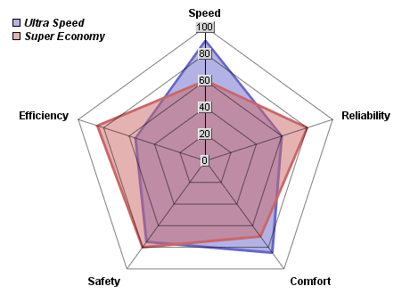
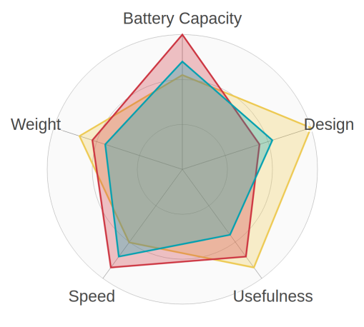
PIC18F: Exercise learnings!
There are many, many ways to write code
Almost all will ‘do the job’
For multiple algorithms, evaluate ‘relative cost’:
Code (space)
Time (speed)
Energy (power-draw)
Modularity (maintenance)
Re-use (library)
Production code is a cost-optimization problem
Embedded ‘mantra’: write less code to do more!

Slide 23
Compare instructions

Slide 24
PIC18F: Instructions - comparison
CPFSEQ
Compare FREG (with W) and Skip if Equal
Skip if [FREG] == [WREG]
CPFSGT
Compare FREG (with W) and Skip if Greater than
Skip if [FREG] > [WREG]
CPFSLT
Compare FREG (with W) and Skip if Less than
Skip if [FREG] < [WREG]

Slide 25
PIC18F: Exercise #2: Comparison
Problem statement:
Increment FREG 0x40 in steps of d’10’ till you reach d’100’
Algorithm:
Define 2 FREGs, FREG1 and FREG2
Initialize [FREG1] to d’0’ - will be incremented
Initialize [FREG2] to d’100’ - will hold the final value
Implement a loop
Add d’10’ to [FREG]
Check [FREG1] and [FREG2] for equality
Exit the loop if the two become equal
Loop without counter!
But has a clear exit condition

Slide 26
PIC18F: Exercise #2 – code
#include “P18F4520.inc”
FREG1 EQU 0x40
FREG2 EQU 0x50
STEP EQU d’10’
FINAL EQU d’100’
ORG 0x0
CLRF FREG1
MOVLW FINAL
MOVWF FREG2 ; [FREG2] = FINAL
LOOP MOVLW STEP
ADDWF FREG1, F ; [FREG1] += STEP
MOVF FREG2, W
CPFSEQ FREG1 ; Compare [FREG1] & [WREG]
BRA LOOP
GOTO $
END

Slide 27
Functions

Slide 28
Programming: Concept of modularity
Divide and Rule
When faced with a big problem
Break it down into small manageable pieces / chunks
In the computing / coding world
Manifests as modular code
Functions, sub-routines
Function
Independent piece of code that does ‘some work’
Needs to be ‘called’
After doing the work, it ‘returns’ back to the ‘caller’
Code re-use:
Same code can be called any number of times!

Slide 29
PIC18F: Function – structure
Function body:
FUNC1 ADDLW 0x04
SUBWF 0x30 “function body”
MOVWF 0x45
RETURN
Function call:
Inst^{n} #n
CALL FUNC1
Inst^{n} #n+1

Slide 30
PIC18F: Instructions – function calls
CALL
Call the function with that label
Example: CALL FUNC1
4-byte instruction – 20 bits for JUMP-TO address
Can jump anywhere within the code space
RCALL
Short call the function with that label
Example: RCALL FUNC1
2-byte instruction – 11 bits for JUMP-TO address
Jump restricted to a range of 2048
RETURN
Return from the function – back to caller
Tip: RCALL saves code-space when jump is short

Slide 31
PIC18F: Functions and the stack
Example: View of code memory
Code address Instructions
m₁ Inst^{n} #n
m₂ CALL FUNC1
m₃ Inst^{n} #n+1
Function call sequence
The code address after the function call is saved
m₃ is ‘pushed’ to the stack
FUNC1 ‘runs’
[PC] = FUNC1’s code address
When FUNC1 returns, stored address is ‘popped’ from the stack
[PC] = m₃
Code flow returns to the point after the function call

Slide 32
PIC18F: LIFO Stack for nested functions
Code with nested functions
PC and Stack interactions
Instn #n
CALL FUNC1
Instn #n+1
…
FUNC1 Instn #o
Instn #o+1
CALL FUNC2
Instn #o+2
RETURN
FUNC2 Instn #p
Instn #p+1
RETURN
[PC] sequence: n, o, o+1, p, p+1, o+2, n+1
[PC] = Addr (#n)
- FUNC1 called, Stack push
[PC] = Addr(#o), SP = Addr(#n+1)
- FUNC1 runs
[PC] = Addr(#o+1)
- FUNC2 called, Stack push
[PC] = Addr(#p), SP = Addr(#o+2)
- FUNC2 runs
[PC] = Addr(#p+1)
- FUNC2 returns, Stack pop, FUNC1 runs
[PC] = Addr(#o+2)
- FUNC1 returns, Stack pop, Back!
[PC] = Addr(n+1)

Slide 33
Programming: Software delay
Concept of a delay
A wait for a fixed amount of time
Used for interacting with devices at different speeds
A function to generate a delay
Generating delay by writing code – ‘software delay’
Function body:
Create a loop (initialize a counter)
Loop body:
Idle – do nothing!
Decrement the counter
If the counter is not-zero, rinse and repeat!
Else, exit the loop
Return from the function

Slide 34
PIC18F: Functions: Software delay
Main code
Function
CNTR EQU 0x50
DLY_VAR EQU 0x20
ORG 0x0
…
CALL DELAY
…
…
CALL DELAY
…
►Code re-use
►Modularity
ORG 0x300
DELAY MOVLW DLY_VAR
MOVWF CNTR
LOOP NOP
NOP
NOP
DECF CNTR, F
BNZ LOOP
RETURN

Slide 35
PIC18F: Why not software for delay?
Software delay code is rarely used in production
Issues with software generated delays:
Poor ability to give ‘strict’, ‘precise’ delays
If interrupts are enabled, can get interrupted when running delay code
Once interrupted:
Has to suspend running the delay code
On return, resumes running the delay code
Wasteful way of generating a delay
NOP also consumes power!
As code size and complexity grows
Difficult to tune delay functions for exactness
So what do we use?
Hardware generated delays – timers, counters

Slide 36
PIC18F: Return value from functions
Functions can do more than ‘perform work’
They can take values from the caller
Called input arguments
They can also give back values to the caller
Called return values / output arguments
Caller - callee interaction : bi-directional
WREG is usually used for these purposes
An example of WREG used for returning values
Instruction: RETLW
Return from a function with Data in WREG
Example: RETLW 0x20
Effect: [WREG] = 0x20, automatic return

Slide 37
Programming: Implementing lookups
Implement a function that returns the square of input
Assume input 0 ≤ x ≤ 9
Let’s call the function SQR
Let’s use WREG as input as well as output argument
Examples:
For [WREG] = 0x02, CALL SQR should return [WREG] = 0x04
For [WREG] = 0x03, CALL SQR should return [WREG] = 0x09, …
Pre-compute answers and store them – ‘lookup table’
Code structure:
Main code: Fills WREG with x, calls SQR
Function code (SQR): Computes and returns x² in WREG

Slide 38
PIC18F: Squaring by lookup table
INPUT EQU 0x02
OUT_REG EQU 0x30
ORG 0x0
MOVLW INPUT ; [WREG] = INPUT
CALL SQR
MOVWF OUT_REG ; [OUT_REG] = Answer!
SQR MULLW 0x02 ; [PRODL] = [WREG] x 2
MOVF PRODL, W ; bring it back to WREG
ADDWF PCL, F ; [PCL] += [WREG] + 2
RETLW d’0’
RETLW d’1’
RETLW d’4’
…
RETLW d’81’
► 16-bit (2-byte) inst^{n} → [PCL] += 2 by default
► [PCL] += 2 + 2*input
► Strategically place RETLWs to return the square in WREG
input | 2*input
0 | 0
1 | 2
2 | 4

Slide 39
PIC18F: Journey so far
Algorithmic options
Good code, not-so-good code
Looping
NOP
Comparison-induced branching
Functions
Modularity
Code re-use
Scalability – teams of programmers
Function call related
CALL, RCALL
RETURN, RETLW

Slide 40
PIC18F: Instructions – Part 2 Summary
Programming constructs
Branching
Unconditional, conditional
Comparison
Looping
Loop entry, exit
Delay generation using loops
Functions
Call, return, nesting
Lookup tables

Slide 41
Thank you!

